Slide 1
Visual secret sharing

Slide 2
Overview
Visual cryptography is a cryptographic technique which allows visual information (pictures, text, etc.) to be encrypted in such a way that the decrypted information appears as a visual image.
In 1994, Naor and Shamir present a secret sharing method where an image is broken into n shares and any n - 1 shares are not enough to decrypt it.
Using similar idea, transparencies can be used to implement a one-time pad encryption, where one transparency is a shared random pad, and another transparency acts as the cipher text.

Slide 3
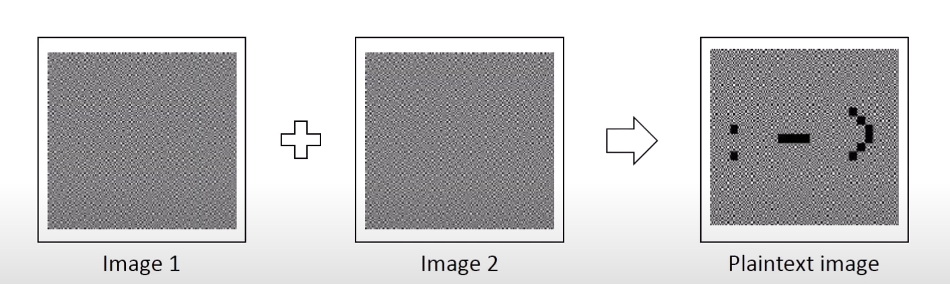
Encryption and Decryption
We create one image (Image 1) which acts as shared one-time-pad and another image (Image 2) which is our ciphertext
When we combine image 1 and image 2, we get our plaintext image.
This work also by printing image 1 and image 2 on plastic sheets and overlaying these.

Slide 4
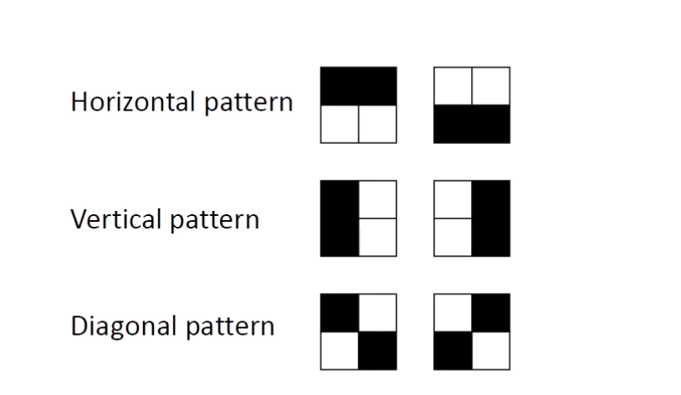
Encryption and Decryption
Because we encrypt black & white image, we need to encrypt black and white pixels.
We need different encryption pattern for encryption.
We use three different 2x2 patterns as defined as follow:

Slide 5
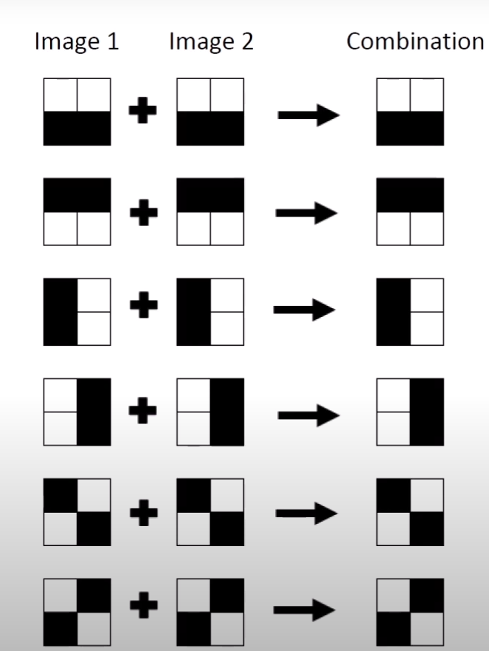
Encryption and Decryption
For white pixel, we use for each image the same randomly chosen pattern

Slide 6
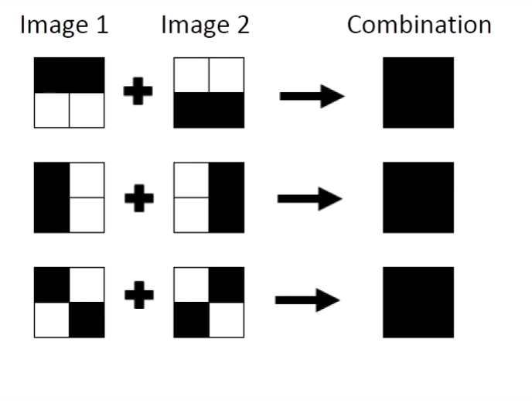
Encryption and Decryption
For black pixel, we use for each image a randomly chosen pattern and it inverse:

Slide 7
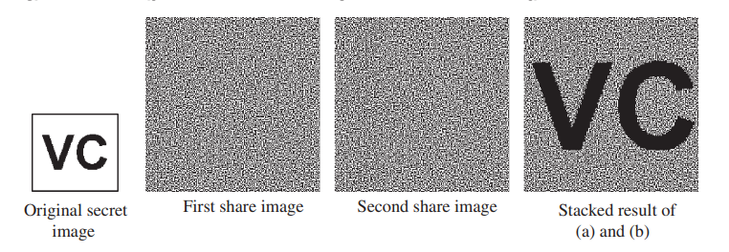
Example

